Slide 1
THE ELEPHANTS IN THE ROOM
Notes:
I daresay we’ve probably, at one time or another, either heard or used the phrase “the elephant in the room.” Normally depicted as pink, I choose to use purple because – well I can!

Slide 2
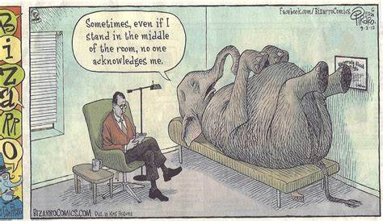
Notes:
Thanks to Google, the Cambridge Dictionary defines “the elephant in the room” idiom as an obvious problem or difficult situation that people do not want to talk about.”

Slide 3
LACK OF TRUST WOUNDING/WOUNDED FINANCES COMMUNICATION
Notes:
When I joined you as Transitional General Presbyter in November of 2020, it didn’t take long for me to identify the presence of elephants. So in February of 2021, the Executive Council took the bold step of dedicating their meeting to talking about, identifying, and naming Salem Presbytery’s “elephants in the room”. Members of the Dream Team and Implementation Team also participated in that work session. From the hard, faithful work on that February day, of both small groups and the group as a whole, emerged a document that has come to be known as the “elephants document.”
On behalf of, and at the request of Executive Council, I present the “elephants document” to you – the body of Salem Presbytery – not only to let you know what has been identified, but to share what progress has been made to remove the elephants from the room. Having entered the room as youngsters, the elephants have grown over time. And the only way to remove a full-grown elephant from a room is piece by piece. But Council also wants your input. We want to know – from you – what might have been left off the list. We’ll get to that exercise in a bit.
So – here goes – CLICK SO THE ISSUES APPEAR –
LACK OF TRUST
WOUNDING/WOUNDED
FINANCES
COMMUNICATION
As we take them one at a time, PLEASE NOTE: Anything in RED are the identified issues. Other comments were added as a way to address the elephants. Anything highlighted in YELLOW have begun to be addressed or are completed!

Slide 4
LACK OF TRUST In order to begin to build trust, people have to get to know one another as people, not issues by –
- Engagement Pastors connecting in parishes - Parishes connect to other parishes - Area lunches/get togethers - Small Gatherings - Large Gatherings for Fellowship
-Committees/Executive Council/Staff promise when to expect results on projects/questions and keep the promise. If we can’t keep to the schedule explain why and set another goal date ACCOUNTABILITY
-Regular updates and clear communication from committees, Executive Council, and staff to the whole presbytery and to and with one another – TRANSPARENCY Also shared - Easier to be vulnerable in small groups Factions Us/Them
Notes:
LACK OF TRUST –
The only way to change this is to begin to be seen as trustworthy through accountability and transparency.
Talk through slide

Slide 5
WOUNDING/WOUNDED[NESS]
- Staff – previous issues on how they were treated and let go – acknowledge the hurt; offer corporate apology to each; enter acknowledgment and apology into the Presbytery Minutes
- Address how some in the presbytery, Dream Team, Executive Council, and Implementation Team were treated by upset and angry staff, as well as fellow presbyters over the past couple of years. Acknowledge this hurt simultaneous to above, offer corporate apology to these work teams in particular, and also enter this into the Presbytery Minutes.
NOTE: When we dissolved the Implementation Team at the February 2021 meeting, we engaged in a litany which addressed these concerns.
- Dream Team process – acknowledge the hurt, confusion, and division that this process resulted in for some staff, some in the presbytery, and then, by their reactions, also for members of the Dream Team. This has continued after the plan passed as it felt like it never became a “presbytery plan” but still remained a Dream Team plan.
Notes:
WOUNDING/WOUNDEDNESS –
Talk through slide, and then –
In keeping with building trust through accountability, including when to expect certain outcomes – I was planning that our first meeting where we can be face to face will include a service of wholeness and healing. So we don’t put this off any longer, I’m now thinking that might best happen in November when we gather in Parishes, and the parishes connect via Zoom.

Slide 6
FINANCES
Not sure I could trust info being presented and still not sure I can
Not getting info on restricted accounts
Never questioned funds in the past
Per Capita arrearages
Crisis never explained
Deficit budget
-There has to be repentance and forgiveness for self and the body for “never questioning funds”
-A “position paper” should be prepared explaining how we got to where we are – including an explanation of the per capita mess – we don’t need to place blame
-The Synod is carrying 2018 per capita on its books
-Restricted funds are now being looked at
Would like to see GA and Synod “total ask” vs. amount budgeted
Notes:
As has been reported, we received forgiveness of outstanding per capita.
AND – a report on restricted funds has been completed by Ronda Tatum, a task force from Finance and EC met to look at possibilities and make recommendations. That report is now in the hands of Council.
Talk through slide

Slide 7
COMMUNICATION
- No room for conservative voices
- Have hard time asking hard questions – and what happens if you do (i.e. previous staff)
- Not a clear sense of presbytery as a whole of the Dream Team/Implementation Team plan and ownership of it by the presbytery as a whole
Also shared –
Felt like people wanted me to “shut up”
I think once people see progress on other things, there will be more of a willingness to speak up and speak out. That can’t be done until we begin to build positive relationships and accountability.
Notes:
In process and will be a forever work in process
Talk through slide

Slide 8
WE NEED TO HEAR FROM YOU! After this meeting, you will be receiving a reminder of this request, together with a link to access a google form. All comments will be captured into one document which Executive Council will review and then share with the body as a whole.
Notes:
We need your help.

Slide 9
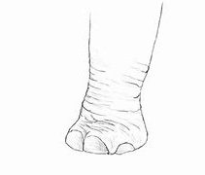
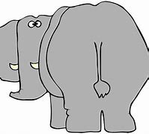
Let’s move the elephant out of the room so Salem Presbytery can move forward into God’s intended future, with hope!
Notes:
It’s time to remove the elephant from the room – issue by issue / piece by piece.

